Slide 1

REPLICATE

Slide 2
PRESENTED BY TATA NGWA BILLY
On The Occasion Of The Defense of level one Projects
For Full Stack Web Development
21/10/2022

Slide 3
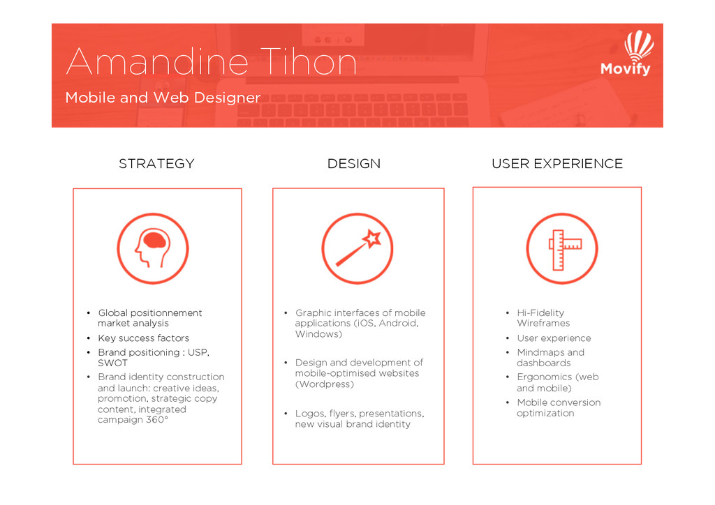






OUTLINE
INTRODUCTION
PROBLEMS
SOLUTIONS
CONCLUSION
REMARKS

Slide 4

INTRO
DUCTION

Slide 5

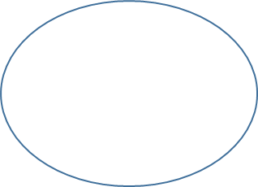
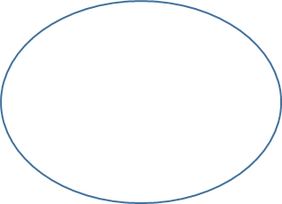

PRO
BLEMS
HOW I CAME TO THE ACADEMY
MAKING MY
MIND MADE UP
MY EXPERIENCE
BEFORE
THE SMART
MOVE
THE ULTIMATE
TRIGGER
THE NEXT MOVE

Slide 6




SOLU
TION
I SAW AND FILLED A GOOGLE FORM
CHANGING MY
GOAL PERSPECTIVES
MY EXPERIENCE
AFTER
THE SMART
MOVE
THE ULTIMATE
TRIGGER INCREASED
THE NEXT MOVE

Slide 7




CONCLU
SION

Slide 8
REPLICATE
THANKS FOR LISTENING

